Slide 1
Unit 1: Algorithm Basics & Analysis - Asymptotic notation
Name of the Faculty : Dr. Anurag Jain
Designation : Assistant Professor (SG)
Email id : anurag.jain@ddn.upes.ac.in

Slide 2
Asymptotic Notation
Asymptotic Notations are languages that allow us to analyze an algorithm's running time by identifying its behavior as the input size for the algorithm increases. This is also known as an algorithm's growth rate.
There are five different asymptotic notations:
Big Oh - O
Big Omega - Ω
Big Theta - Θ
Little oh - o
Little Omega - ω

Slide 3
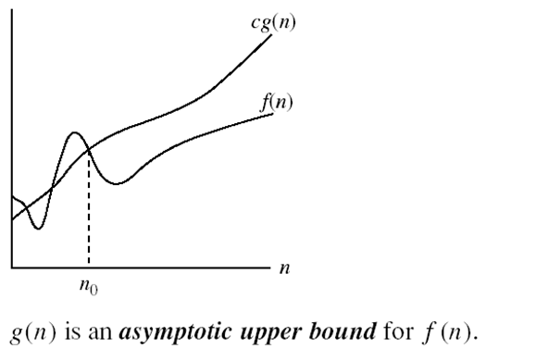
Asymptotic Notation- Big Oh
A function f(n) will be related to function g(n) through big oh i.e. f(n)= O(g(n)) iff there exists positive constants c and n₀ such that 0 ≤ f(n) ≤ c*g(n) for all n ≥ n₀. Function g(n) will act as a upper bound for function f(n).

Slide 4
Asymptotic Notation- Big Oh- examples
Show that 2n² = O(n³):
2n² ≤ c*n³ ⇒ 2 ≤ c*n ⇒ c = 1 and n₀= 2
Show that n² = O(n²):
n² ≤ c*n² ⇒ c ≥ 1 ⇒ c = 1 and n₀= 1
Show that 1000n²+1000n = O(n²):
1000n²+1000n ≤ 1000n²+ n² =1001n²⇒ c=1001 and n₀ = 1000
Show that n = O(n²):
n ≤ c*n² ⇒ c*n ≥ 1 ⇒ c = 1 and n₀= 1

Slide 5
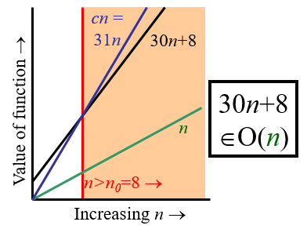
Asymptotic Notation- Big Oh- examples
Show that 30n+8 is O(n):
We have to show that ∃c, n₀ : 30n+8 ≤ c*n, ∀n>n₀
c=31 and n₀=8
Note 30n+8 isn’t less than n anywhere (n>0).
It isn’t even less than 31n everywhere.
But it is less than 31n everywhere to the right of n=8.

Slide 6
Asymptotic Notation- Big Oh- Some more facts
There is no unique set of values for n₀ and c in proving the asymptotic bounds
Prove that 100n + 5 = O(n²)
100n + 5 ≤ 100n + n = 101n ≤ 101n² for all n ≥ 5
so n₀ = 5 and c = 101 is a solution
100n + 5 ≤ 100n + 5n = 105n ≤ 105n² for all n ≥ 1
so n₀ = 1 and c = 105 is also a solution
Must find SOME constants c and n₀ that satisfy the asymptotic notation relation

Slide 7
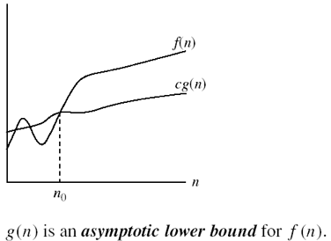
Asymptotic Notation- Big Omega
A function f(n) will be related to function g(n) through big omega i.e. f(n)= Ω(g(n)) iff there exists positive constants c and n₀ such that f(n) ≥ c*g(n) ≥0 for all n ≥ n₀. Function g(n) will act as a lower bound for function f(n).

Slide 8
Asymptotic Notation- Big omega- examples
Show that 5n² = Ω (n):
0 ≤ c*n ≤ 5n² ⇒ c*n ≤ 5*n² ⇒ c = 1 and n₀= 1
Show that 100n+5 ≠ Ω (n²):
∃ c, n₀ such that: 0 ≤ cn² ≤ 100n + 5
100n + 5 ≤ 100n + 5n (∀ n ≥ 1) = 105n
cn² ≤ 105n ⇒ n(c*n – 105) ≤ 0
Since n is positive ⇒ c*n – 105 ≤ 0⇒ n ≤ 105/c
⇒ contradiction: n can’t have value in a range
Show that n = Ω (2n) Show that n³ = Ω (n²) Show that n = Ω (logn)
c=1/2 and n₀= 1 c = 1 and n₀= 1 c = 1 and n₀= 1

Slide 9
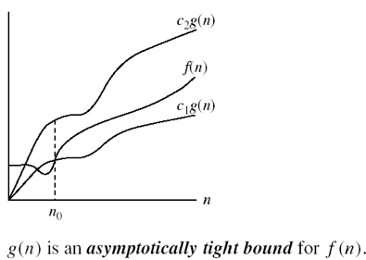
Asymptotic Notation- Big Theta
A function f(n) will be related to function g(n) through big Theta i.e. f(n)= Θ(g(n)) iff there exists positive constants c₁, c₂ and n₀ such that 0 ≤ c₁ *g(n) ≤ f(n) ≤ c₂*g(n) for all n ≥ n₀. Function g(n) will act as a lower bound for function f(n).

Slide 10
Asymptotic Notation- Big Theta- examples
Show that n²/2 –n/2 = Θ(n²)
½ n² - ½ n ≤ ½ n² ∀n ≥ 0 ⇒ c₂= ½
½ n² - ½ n ≥ ½ n² - ½ n * ½ n ( ∀n ≥ 2 ) = ¼ n² ⇒ c₁= ¼
So c₁= ¼ , c₂= ½ and n₀=2
Show that n ≠ Θ (n²):
c₁*n² ≤ n ≤ c₂*n²
only holds for: n ≤ 1/c₁

Slide 11
Asymptotic Notation- Big Theta- examples
Show that 6n³ ≠ Θ (n²):
c₁*n² ≤ 6n³ ≤ c₂*n²
only holds for: n ≤ c₂/6
Show that n ≠ Θ (logn):
c₁*logn ≤ n ≤ c₂*logn
only holds for: c₂ ≥ n/logn

Slide 12
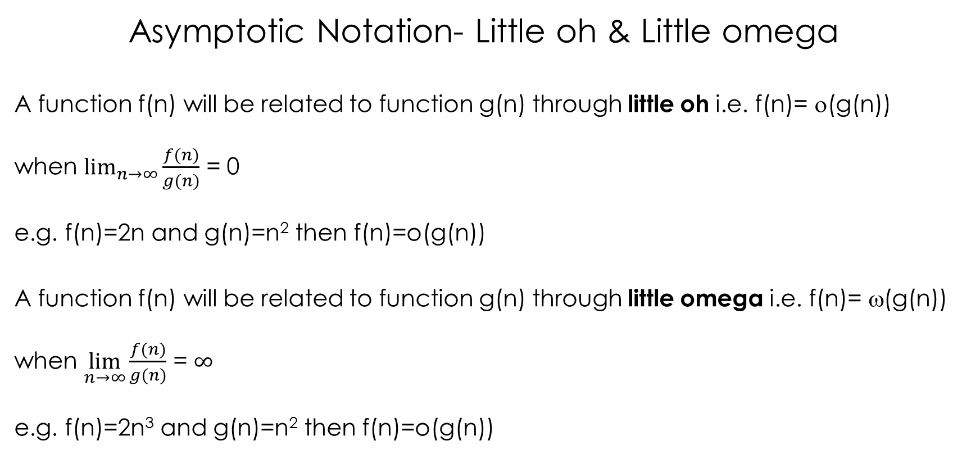
Asymptotic Notation- Little oh & Little omega
A function f(n) will be related to function g(n) through little oh i.e. f(n)= ο(g(n))
when $\lim_{n→∞}{\frac{f(n)}{g(n)}}$ = 0
e.g. f(n)=2n and g(n)=n² then f(n)=o(g(n))
A function f(n) will be related to function g(n) through little omega i.e. f(n)= ω(g(n))
when $\lim_{n→∞}{\frac{f(n)}{g(n)}}$ = $∞$
e.g. f(n)=2n³ and g(n)=n² then f(n)=o(g(n))

Slide 13
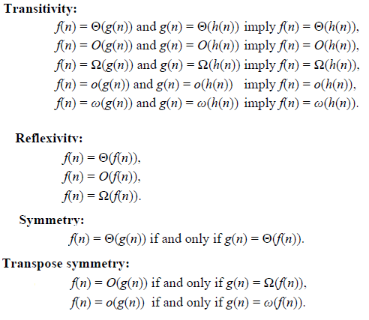
Properties of Asymptotic Notation

Slide 14
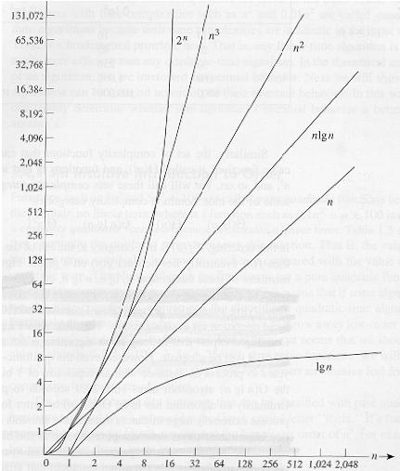
Common orders of magnitude
O(c) will be used to denote constant computing time.
O(log(n)) is called logarithmic computing time.
O(n) is called linear computing time.
O(n*log(n)) is called variable times logarithmic computing time.
O(n²) is called quadratic computing time.
O(2^{n}) is called exponential computing time.
O(C)≤O(log(n)) ≤O(n) ≤O(n*log(n)) ≤O(n²) ≤O(2^{n})

Slide 15
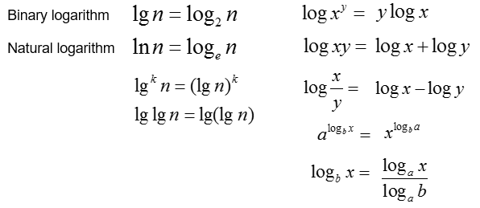
Logarithms and properties
In algorithm analysis we often use the notation “log n” without specifying the base

Slide 16
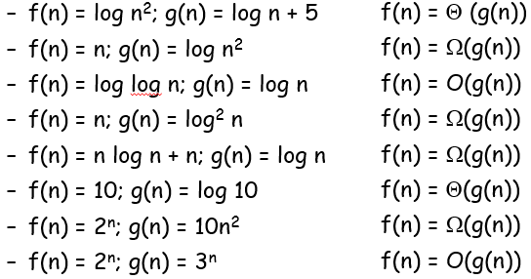
More Examples
For each of the following pairs of functions, either f(n) is O(g(n)), f(n) is Ω(g(n)), or f(n) = Θ(g(n)). Determine which relationship is correct.

Slide 17
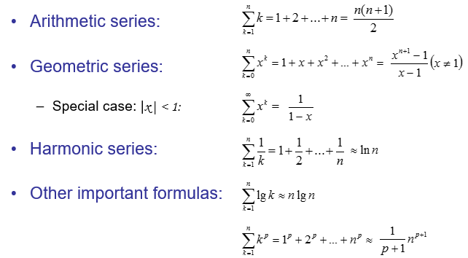
Common Formulas

Slide 18
Monotonicity
f(n) is
monotonically increasing if m ≤ n ⇒ f(m) ≤ f(n).
monotonically decreasing if m ≤ n ⇒ f(m) ≥ f(n).
strictly increasing if m < n ⇒ f(m) < f(n).
strictly decreasing if m < n ⇒ f(m) > f(n)

Slide 19
Exponentials
Useful identities
Exponential and Polynomials

